Slide 1
19CSE305: ENSEMBLE LEARNING

Slide 2
ENSEMBLE MODEL
A model that makes predictions based on a number of different models.
By combining individual models, the ensemble model tends to be:
more flexible(less bias)
less data-sensitive (less variance).
Bagging
Boosting
Stacking
Machine learning paradigm where multiple models (often called “weak learners”) are trained to solve the same problem and combined to get better results.
Homogeneous
ensembles model
Heterogeneous
ensembles model

Slide 3
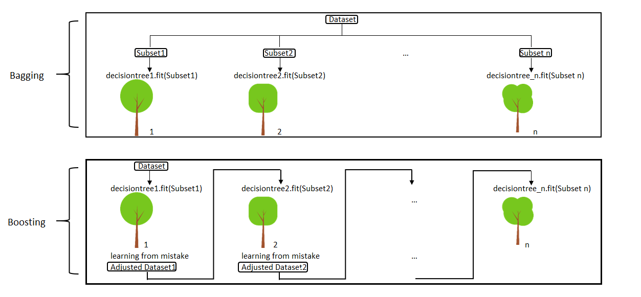
Bagging
Training a bunch of individual models in a parallel way. Each model is trained by a random subset of the data

Slide 4
Boosting
Training a bunch of individual models in a sequential way.
Each individual model learns from mistakes made by the previous model.
Fit models iteratively such that the training of model at a given step depends on the models fitted at the previous steps.

Slide 5
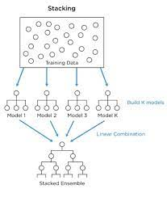
Stacking
Heterogeneous weak learners
Learns them in parallel and combines them by training a meta-model to output a prediction based on the different weak models predictions.

Slide 6
ENSEMBLE MODEL
EXAMPLES:
Random Forest --------- Bagging
Ada boost ---------------Boosting
Gradient Boosting-------Boosting

Slide 7
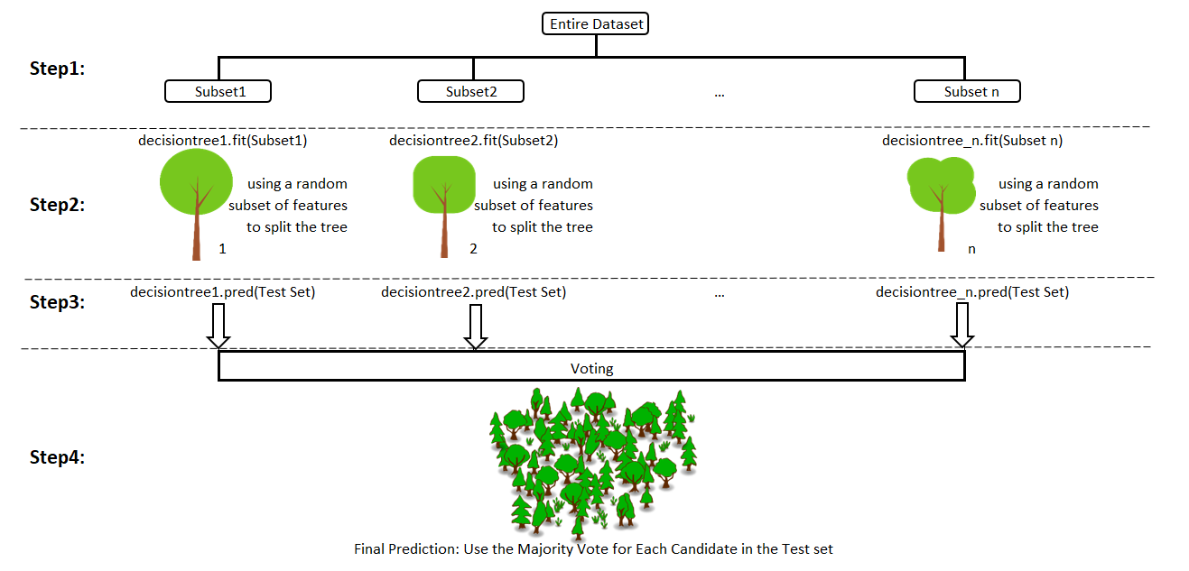
Random Forest
Ensemble model using bagging as the ensemble method and decision tree as the individual model

Slide 8
Random Forest
Step 1: Select n (e.g. 1000) random subsets from the training set.
Step 2: Train n (e.g. 1000) decision tree
One random subset is used to train one decision tree
The optimal splits for each decision tree are based on a random subset of features (e.g. 10 features in total, randomly select 5 out of 10 features to split
Step 3: Each individual tree predicts the records/candidates in the test set, independently.
Step 4: Make the final prediction

Slide 9
Adaboost-Adaptive Boosting
First Boosting Algorithm
Model: Weighted sum of L weak learners
Iterative optimization process : add the weak learners one by one,
looking at each iteration for the best possible pair (coefficient, weak learner)

Slide 10
Adaboost-Adaptive Boosting
AdaBoost: learns from the mistakes by increasing the weight of misclassified data points.
Step 0: Initialize the weights of data points. if the training set has 100 data points, then each point’s initial weight should be 1/100 = 0.01.
Step 1: Train a decision tree
Step 2: Calculate the weighted error rate (e) of the decision tree.
→ how many wrong predictions out of total

Slide 11
Adaboost-Adaptive Boosting
Step 3: Calculate this decision tree’s weight in the ensemble
= learning rate * log( (1 — e) / e)
The higher weighted error rate of a tree, the less decision power the tree will be given during the later voting
The lower weighted error rate of a tree, the higher decision power the tree will be given during the later voting
Step 4: Update weights of wrongly classified points
the weight of each data point =
if the model got this data point correct, the weight stays the same
if the model got this data point wrong, the new weight of this point = old weight * exp(weight of this tree)
Step 5: Repeat Step 1-4(until the number of trees we set to train is reached)
Step 6: Make the final prediction

Slide 12
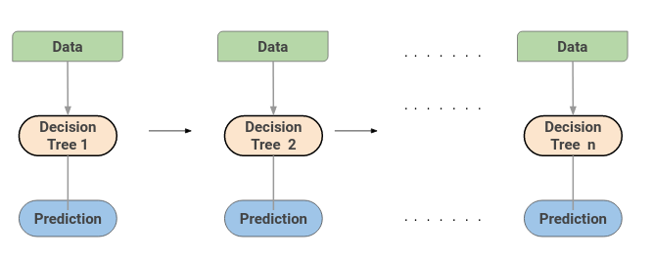
Gradient Boosting
Gradient boosting involves three elements:
A loss function to be optimized.
A weak learner to make predictions.
An additive model to add weak learners to minimize the loss function.
Loss Function
The loss function used depends on the type of problem being solved.
Regression -squared error and classification may use logarithmic loss.
Weak Learner
Decision trees are used as the weak learner in gradient boosting.
Initially, very short decision trees were used that only had a single split, called a decision stump.
Larger trees can be used generally with 4-to-8 levels.

Slide 13
Gradient Boosting
Gradient boosting involves three elements:
A loss function to be optimized.
A weak learner to make predictions.
An additive model to add weak learners to minimize the loss function.
Loss Function
The loss function used depends on the type of problem being solved.
Regression -squared error and classification may use logarithmic loss.
Weak Learner
Decision trees are used as the weak learner in gradient boosting.
Initially, very short decision trees were used that only had a single split, called a decision stump.
Larger trees can be used generally with 4-to-8 levels.

Slide 14
Improvements to Basic Gradient Boosting
Regularization methods:
Tree Constraints
Number of trees -generally adding more trees to the model can be very slow to overfit. The advice is to keep adding trees until no further improvement is observed.
Tree depth -deeper trees are more complex trees and shorter trees are preferred. Generally, better results are seen with 4-8 levels.
Number of nodes or number of leaves
Number of observations per split
Minimum improvement to loss
Weighted Updates
The predictions of each tree are added together sequentially.
The contribution of each tree to this sum can be weighted to slow down the learning by the algorithm. This weighting is called a shrinkage or a learning rate.

Slide 15
THANK YOU

